Slide 1

Software Testing
Unit Testing
Instructor: Kaveh Eshraghian

Slide 2
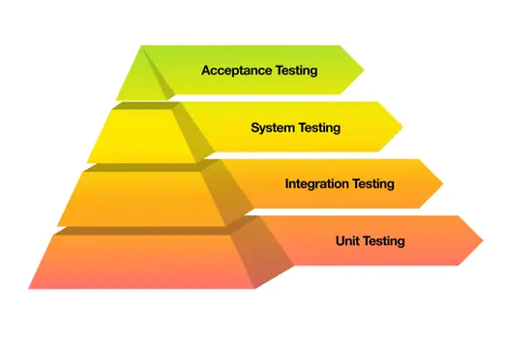
Unit Testing
Definition:
Unit testing is the process of testing the code in small units.
What to Test:
Usually, these units correspond to functions
Steps to Test:
Feeding the function under test specific values.
Gathers a return value and compares it to expected output.
If values produced by the function under test is identical to that that is expected, test has passed

Slide 3
Test Frameworks
Unit test framework advantages:
Allows us to set up the test,
Call the function being tested and store the result,
Compare the result to the expected result
Use an assertion to throw an exception if the test fails
Tear down the test
Test Setup
Execute
Test Teardown
Check result

Slide 4
Test Coverage
Definition:
The extent to which the source code of a software application is tested by a set of test cases. It is a metric that helps evaluate the effectiveness and thoroughness of testing efforts.
What to Test:
Measures which line of code were tested.
The number of times each line was executed.
Steps to Test:
Compile code with counting flags (gcc -Wall -fprofile-arcs -ftest-coverage -o insert insert.c)
Execute program.
Prepare report (gcov insert.c)
Open file insert.c.gcov

Slide 5
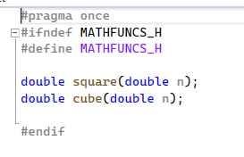
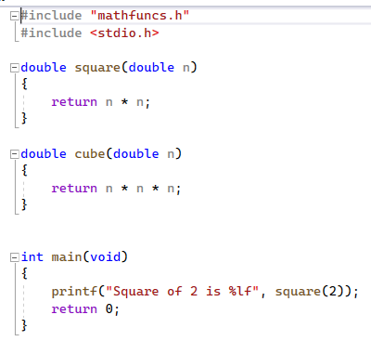
Test Math Functions
mathfuncs.h
mathfuncs.c

Slide 6
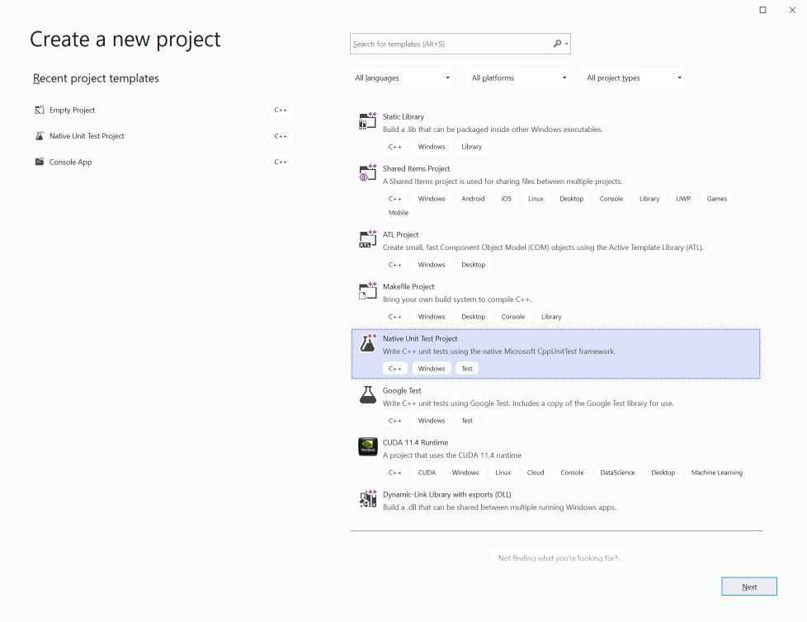
Create a Test Project

Slide 7
Write Test Code
#include "pch.h"
#include "CppUnitTest.h"
#include "mathfuncs_r.h"
using namespace Microsoft::VisualStudio::CppUnitTestFramework;
namespace MathTestSuite
{
TEST_CLASS(MathTest)
{
public:
TEST_METHOD(SquareTest)
{
double d = square(8.0);
Assert::AreEqual(64.0, d);
}
TEST_METHOD(CubeTest)
{
double d = cube(3.0);
Assert::AreEqual(27.0, d);
}
};
TEST_CLASS(MathIntegrationTest)
{
public:
TEST_METHOD(AdditionTest)
{
double d = square(8.0);
double d1 = cube(3.0);
Assert::AreEqual(91.0, d + d1);
}
};
}

Slide 8
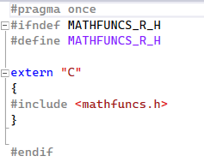
Access C Include File

Slide 9
Assertions
Method | Description
AreEqual(v1, v2 [, "error message"] ) | Compares v1 to v2 and throws an exception if they are not equal. If they are not equal, the optional error string will be displayed.
AreNotEqual(v1, v2 [, "error message"] ) | Compares v1 to v2 and throws an exception if they are equal. If they are equal, the optional error string will be displayed.
IsTrue(b1 [, "error message"] ) | If the Boolean b1 is not true it throws an exception. If not true, the optional error string will be displayed.
IsFalse(b1 [, "error message"] ) | If the Boolean b1 is not false it throws an exception. If not false, the optional error string will be displayed.
Fail([ "error message"] ) | This causes the test to fail and throws an exception. If called, the optional error string will be displayed.

Slide 10
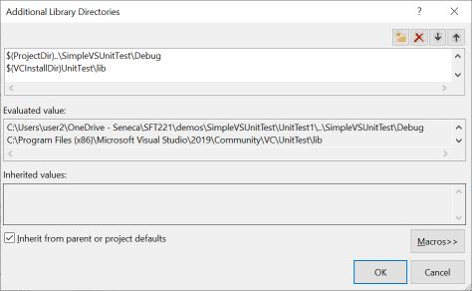
Setup Library Path

Slide 11
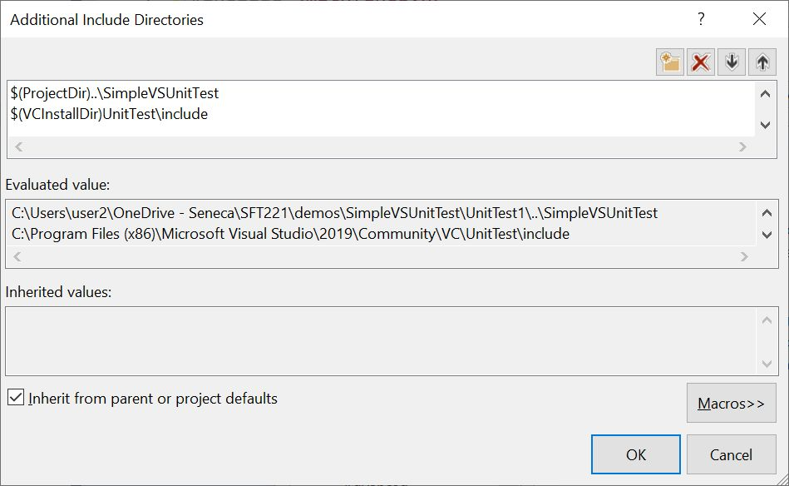
Setup Include Path

Slide 12
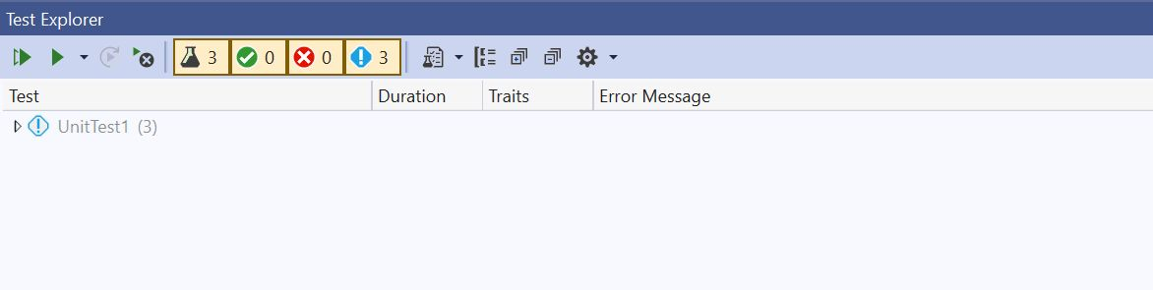
Running Tests in Visual Studio
Go to the Test menu at the top and select Test Explorer.
This will display a new window to control the tests, as shown below.

Slide 13
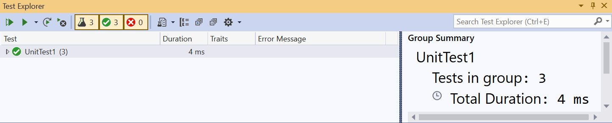
Test Results

Slide 14
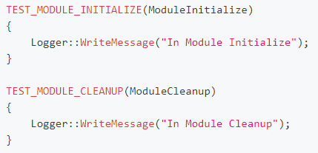
Setup and Teardown Before/After Tests

Slide 15
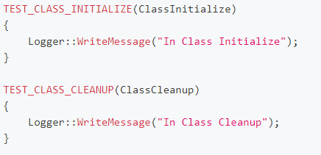
Setup and Teaddown for Each Test

Slide 16
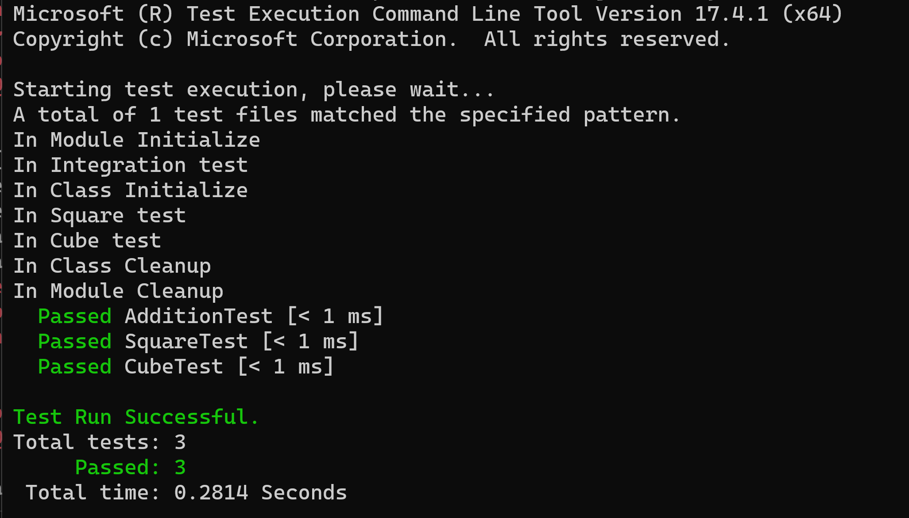
Test from Command Line
vstest.console.exe MathProj-UnitTest.dll

